Slide 1
Architectures for Distributed Systems
Chapter 2

Slide 2
Definitions
Software Architectures – describe the organization and interaction of software components; focuses on logical organization of software (component interaction, etc.)
System Architectures - describe the placement of software components on physical machines
  The realization of an architecture may be centralized (most components located on a single machine), decentralized (most machines have approximately the same functionality), or hybrid (some combination).

Slide 3
Architectural Styles
An architectural style describes a particular way to configure a collection of components and connectors.
  Component - a module with well-defined interfaces; reusable, replaceable
  Connector – communication link between modules
Architectures suitable for distributed systems:
  Layered architectures*
  Object-based architectures*
  Data-centered architectures
  Event-based architectures

Slide 4
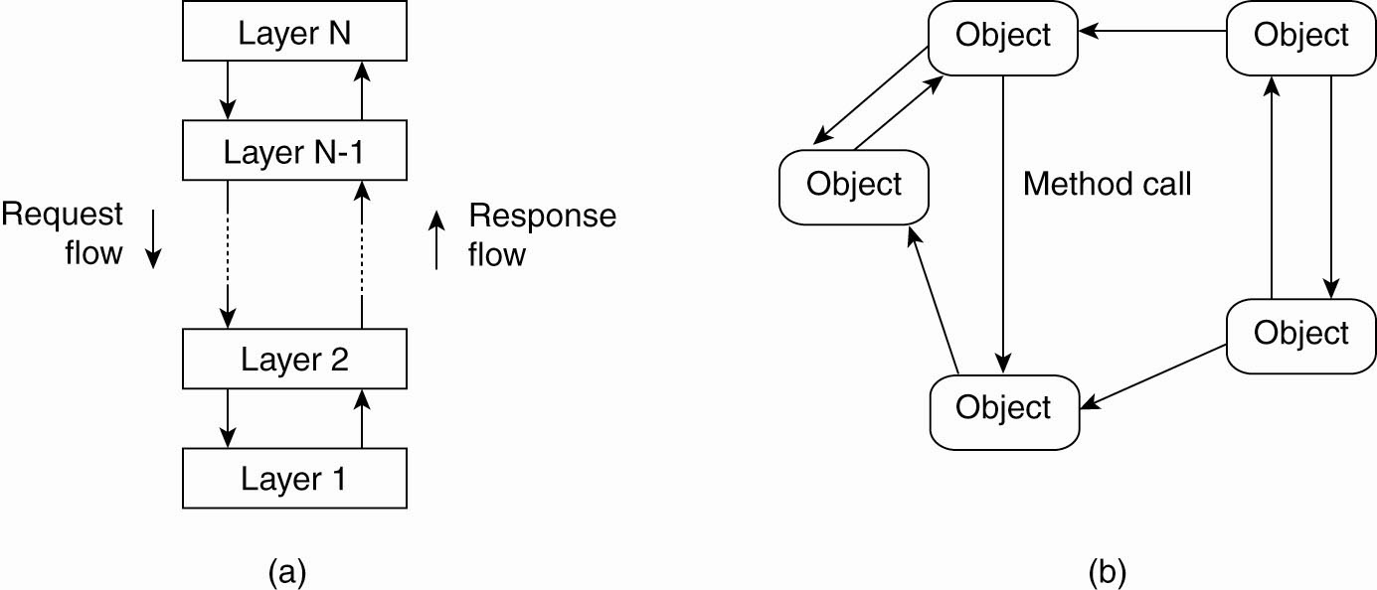
Architectural Styles
Object based is less structured
component = object
connector = RPC or RMI
Figure 2-1. The (a) layered architectural style & (b) The object-based architectural style.

Slide 5
Data-Centered Architectures
Main purpose: data access and update
Processes interact by reading and modifying data in some shared repository (active or passive)
  Traditional data base (passive): responds to requests
  Blackboard system (active): clients solve problems collaboratively; system updates clients when information changes.
Another example: web-based distributed systems where communication is through web services (Ch 12)

Slide 6
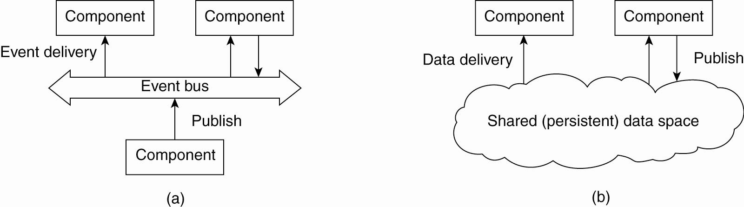
Architectural Styles
Communication via event propagation, in dist. systems seen often in Publish/ Subscribe; e.g., register interest in market info; get email updates
Decouples sender & receiver; asynchronous communication
Event-based arch.
supports several communication styles:
Publish-subscribe
Broadcast
Point-to-point
Figure 2-2. (a) The event-based architectural style

Slide 7
Architectural Styles (5)
Data Centric Architecture; e.g., shared distributed file systems or Web-based distributed systems
Combination of data-centered and event based architectures
Processes communicate asynchronously
Figure 2-2. (b) The shared data-space architectural style.

Slide 8
Distribution Transparency
An important characteristic of software architectures in distributed systems is that they are designed to support distribution transparency.
Transparency involves trade-offs
Different distributed applications require different solutions/architectures
  There is no “silver bullet” – no one-size-fits-all system. (Compare NOW, Seti@home, Condor)

Slide 9
System Architectures for Distributed Systems
Centralized: traditional client-server structure
  Vertical (or hierarchichal) organization of communication and control paths (as in layered software architectures)
  Logical separation of functions into client (requesting process) and server (responder)
Decentralized: peer-to-peer
  Horizontal rather than hierarchical comm. and control
  Communication paths are less structured; symmetric functionality
Hybrid: combine elements of C/S and P2P
  Edge-server systems
  Collaborative distributed systems.
Classification of a system as centralized or decentralized refers to communication and control organization, primarily.

Slide 10
Traditional Client-Server
Processes are divided into two groups (clients and servers).
Synchronous communication: request-reply protocol
In LANs, often implemented with a connectionless protocol (unreliable)
In WANs, communication is typically connection-oriented TCP/IP (reliable)
  High likelihood of communication failures

Slide 11
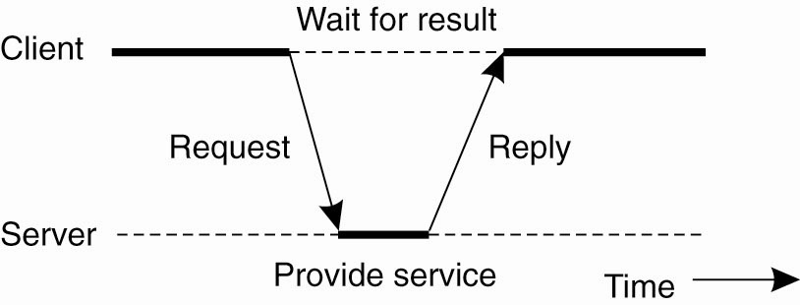
C/S Architectures
Figure 2-3. General interaction between a client and a server.

Slide 12
Transmission Failures
With connectionless transmissions, failure of any sort means no reply
Possibilities:
  Request message was lost
  Reply message was lost
  Server failed either before, during or after performing the service
Can the client tell which of the above errors took place?

Slide 13
Idempotency
Typical response to lost request in connectionless communication: re-transmission
Consider effect of re-sending a message such as “Increment X by 1000”
  If first message was acted on, now the operation has been performed twice
Idempotent operations: can be performed multiple times without harm
  e.g., “Return current value of X”; check on availability of a product
  Non-idempotent: “increment X”, order a product

Slide 14
Layered (software) Architecture for Client-Server Systems
User-interface level: GUI’s (usually) for interacting with end users
Processing level: data processing applications – the core functionality
Data level: interacts with data base or file system
  Data usually is persistent; exists even if no client is accessing it
  File or database system

Slide 15
Examples
Web search engine
  Interface: type in a keyword string
  Processing level: processes to generate DB queries, rank replies, format response
  Data level: database of web pages
Stock broker’s decision support system
  Interface: likely more complex than simple search
  Processing: programs to analyze data; rely on statistics, AI perhaps, may require large simulations
  Data level: DB of financial information
Desktop “office suites”
  Interface: access to various documents, data,
  Processing: word processing, database queries, spreadsheets,…
  Data : file systems and/or databases

Slide 16
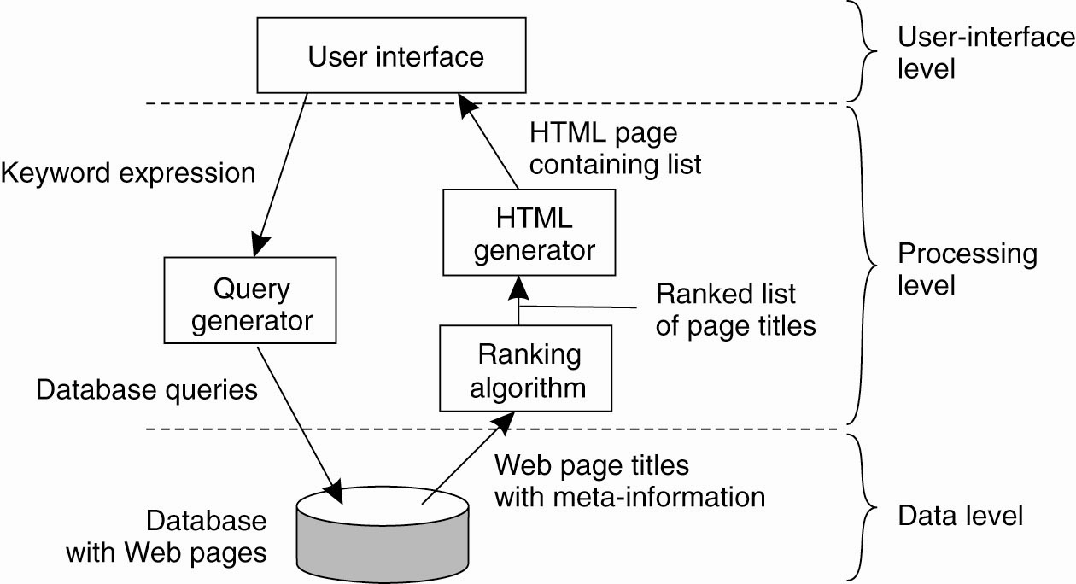
Application Layering
Figure 2-4. The simplified organization of an Internet search engine into three different layers.

Slide 17
System Architecture
Mapping the software architecture to system hardware
  Correspondence between logical software modules and actual computers
Multi-tiered architectures
  Layer and tier are roughly equivalent terms, but layer typically implies software and tier is more likely to refer to hardware.
  Two-tier and three-tier are the most common

Slide 18
Two-tiered C/S Architectures
Server provides processing and data management; client provides simple graphical display (thin-client)
  Perceived performance loss at client
  Easier to manage, more reliable, client machines don’t need to be so large and powerful
At the other extreme, all application processing and some data resides at the client (fat-client approach)
  Pro: reduces work load at server; more scalable
  Con: harder to manage by system admin, less secure

Slide 19
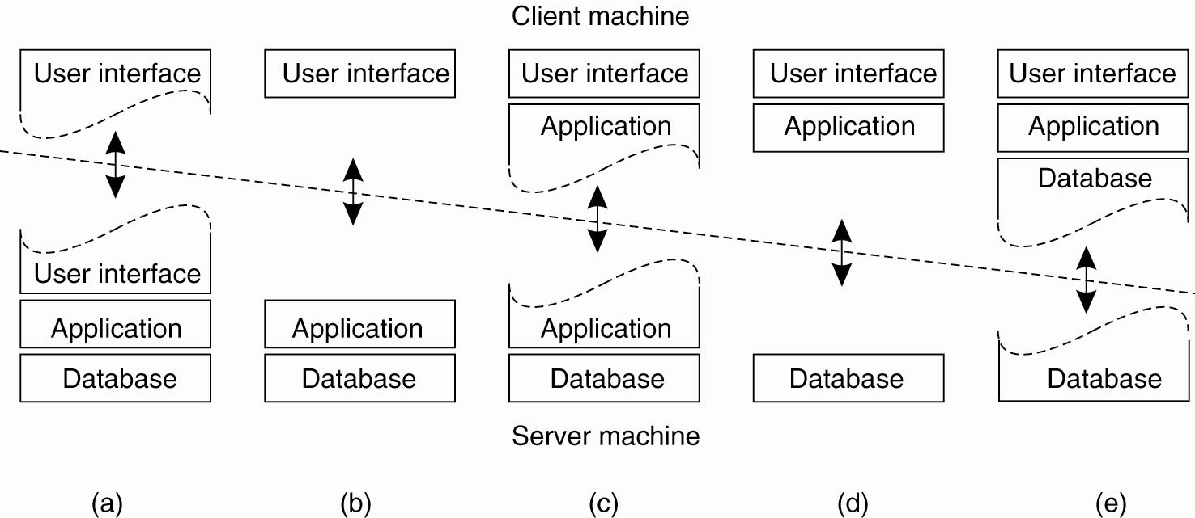
Multitiered Architectures
Thin Client
Fat Client
Figure 2-5. Alternative client-server organizations (a)–(e).

Slide 20
Three-tiered Architectures
In some applications servers may also need to be clients, leading to a three level architecture
  Distributed transaction processing
  Web servers that interact with database servers
Distribute functionality across three levels of machines instead of two.

Slide 21
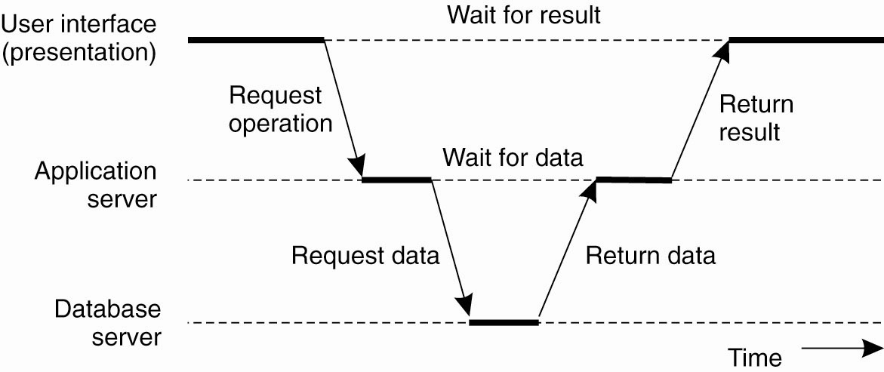
Multitiered Architectures
(3 Tier Architecture)
Figure 2-6. An example of a server acting as client.

Slide 22
Centralized v Decentralized Architectures
Traditional client-server architectures exhibit vertical distribution. Each level serves a different purpose in the system.
  Logically different components reside on different nodes
Horizontal distribution (P2P): each node has roughly the same processing capabilities and stores/manages part of the total system data.
  Better load balancing, more resistant to denial-of-service attacks, harder to manage than C/S
  Communication & control is not hierarchical; all about equal

Slide 23
Peer-to-Peer
Nodes act as both client and server; interaction is symmetric
Each node acts as a server for part of the total system data
Overlay networks connect nodes in the P2P system
  Nodes in the overlay use their own addressing system for storing and retrieving data in the system
  Nodes can route requests to locations that may not be known by the requester.

Slide 24
Overlay Networks
Are logical or virtual networks, built on top of a physical network
A link between two nodes in the overlay may consist of several physical links.
Messages in the overlay are sent to logical addresses, not physical (IP) addresses
Various approaches used to resolve logical addresses to physical.

Slide 25
Circles represent nodes in the network. Blue nodes are also part of the overlay network. Dotted lines represent virtual links. Actual routing is based on TCP/IP protocols
Overlay Network Example

Slide 26
Overlay Networks
Each node in a P2P system knows how to contact several other nodes.
The overlay network may be structured (nodes and content are connected according to some design that simplifies later lookups) or unstructured (content is assigned to nodes without regard to the network topology. )

Slide 27
Structured P2P Architectures
A common approach is to use a distributed hash table (DHT) to organize the nodes
Traditional hash functions convert a key to a hash value, which can be used as an index into a hash table.
  Keys are unique – each represents an object to store in the table; e.g., at UAH, your A-number
  The hash function value is used to insert an object in the hash table and to retrieve it.

Slide 28
Structured P2P Architectures
In a DHT, data objects and nodes are each assigned a key which hashes to a random number from a very large identifier space (to ensure uniqueness)
A mapping function assigns objects to nodes, based on the hash function value.
A lookup, also based on hash function value, returns the network address of the node that stores the requested object.

Slide 29
Characteristics of DHT
Scalable – to thousands, even millions of network nodes
  Search time increases more slowly than size; usually Ο(log(N))
Fault tolerant – able to re-organize itself when nodes fail
Decentralized – no central coordinator
(example of decentralized algorithms)

Slide 30
Chord Routing Algorithm
Structured P2P
Nodes are logically arranged in a circle
Nodes and data items have m-bit identifiers (keys) from a 2^{m} namespace.
  e.g., a node’s key is a hash of its IP address and a file’s key might be the hash of its name or of its content or other unique key.
  The hash function is consistent; which means that keys are distributed evenly across the nodes, with high probability.

Slide 31
Inserting Items in the DHT
A data item with key value k is mapped to the node with the smallest identifier id such that id ≥ k (mod 2^{m})
This node is the successor of k, or succ(k)
Modular arithmetic is used
See figure 2-7 on page 45.

Slide 32
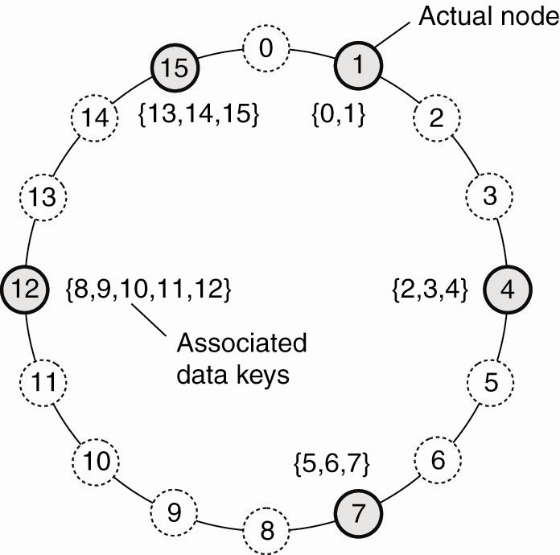
Structured Peer-to-Peer Architectures
Figure 2-7. The mapping of data items onto nodes in Chord for m = 4
Notes:
The connections between nodes are logical connections, not necessarily physical connections.

Slide 33
Finding Items in the DHT
Each node in the network knows the location of some fraction of other nodes.
  If the desired key is stored at one of these nodes, ask for it directly
  Otherwise, ask one of the nodes you know to look in its set of known nodes.
  The request will propagate through the overlay network until the desired key is located
  Lookup time is O(log(N))

Slide 34
Joining & Leaving the Network
Join
  Generate the node’s random identifier, id, using the distributed hash function
  Use the lookup function to locate succ(id)
  Contact succ(id) and its predecessor to insert self into ring.
  Assume data items from succ(id)
Leave (normally)
  Notify predecessor & successor;
  Shift data to succ(id)
Leave (due to failure)
  Periodically, nodes can run “self-healing” algorithms

Slide 35
Summary
Deterministic: If an item is in the system it will be found
No need to know where an item is stored
Lookup operations are relatively efficient
DHT-based P2P systems scale well
BitTorrent and Coral Content Distribution Network incorporate DHT elements
http://en.wikipedia.org/wiki/Distributed_hash_table

Slide 36
Unstructured P2P
Unstructured P2P organizes the overlay network as a random graph.
Each node knows about a subset of nodes, its “neighbors”.
  Neighbors are chosen in different ways: physically close nodes, nodes that joined at about the same time, etc. -
Data items are randomly mapped to some node in the system & lookup is random, unlike the structured lookup in Chord.

Slide 37
Locating a Data Object by Flooding
Send a request to all known neighbors
  If not found, neighbors forward the request to their neighbors
Works well in small to medium sized networks, doesn’t scale well
“Time-to-live” counter can be used to control number of hops
Example system: Gnutella & Freenet (Freenet uses a caching system to improve performance)

Slide 38
Comparison
Structured networks typically guarantee that if an object is in the network it will be located in a bounded amount of time – usually O(log(N))
Unstructured networks offer no guarantees.
  For example, some will only forward search requests a specific number of hops
  Random graph approach means there may be loops
  Graph may become disconnected

Slide 39
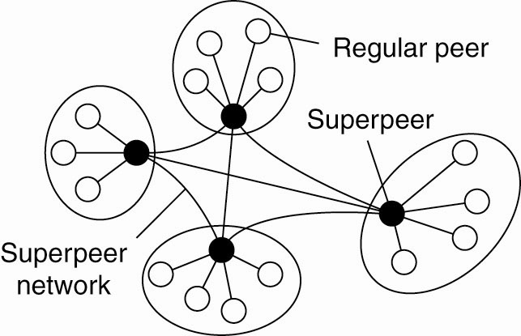
Superpeers
Maintain indexes to some or all nodes in the system
Supports resource discovery
Act as servers to regular peer nodes, peers to other
superpeers
Improve scalability by controlling floods
Can also monitor state of network
Example: Napster
Figure 2-12.

Slide 40
Hybrid Architectures
Combine client-server and P2P architectures
  Edge-server systems; e.g. ISPs, which act as servers to their clients, but cooperate with other edge servers to host shared content
  Collaborative distributed systems; e.g., BitTorrent, which supports parallel downloading and uploading of chunks of a file. First, interact with C/S system, then operate in decentralized manner.

Slide 41
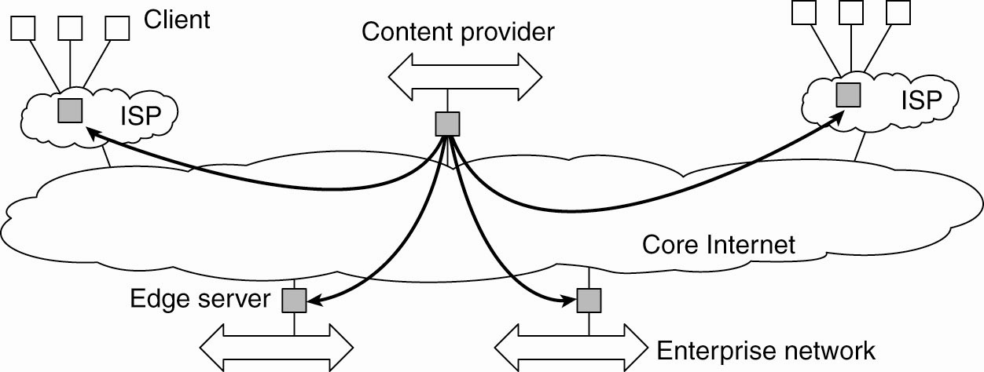
Edge-Server Systems
Figure 2-13. Viewing the Internet as consisting of a collection of edge servers.

Slide 42
Collaborative Distributed Systems BitTorrent
Clients contact a global directory (Web server) to locate a .torrent file with the information needed to locate a tracker; a server that can supply a list of active nodes that have chunks of the desired file.
Using information from the tracker, clients can download the file in chunks from multiple sites in the network. Clients must also provide file chunks to other users.

Slide 43
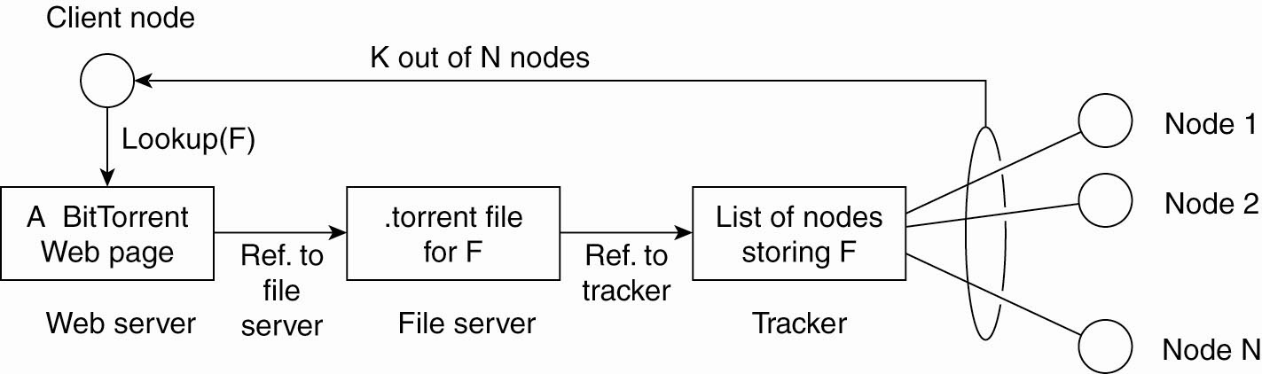
Collaborative Distributed Systems
Trackers know which nodes are active (downloading chunks of a file)
Tells how to locate the tracker for this file
Figure 2-14. The principal working of BitTorrent [adapted with permission from Pouwelse et al. (2004)].

Slide 44
BitTorrent - Justification
Designed to force users of file-sharing systems to participate in sharing.
Simplifies the process of publishing large files, e.g. games
  When a user downloads your file, he becomes in turn a server who can upload the file to other requesters.
  Share the load – doesn’t swamp your server

Slide 45
Freenet
“Freenet is free software which lets you publish and obtain information on the Internet without fear of censorship. To achieve this freedom, the network is entirely decentralized and publishers and consumers of information are anonymous. Without anonymity there can never be true freedom of speech, and without decentralization the network will be vulnerable to attack.”

Slide 46
P2P v Client/Server
P2P computing allows end users to communicate without a dedicated server.
Communication is still usually synchronous (blocking)
There is less likelihood of performance bottlenecks since communication is more distributed.
  Data distribution leads to workload distribution.
Resource discovery is more difficult than in centralized client-server computing & look-up/retrieval is slower
P2P can be more fault tolerant, more resistant to denial of service attacks because network content is distributed.
  Individual hosts may be unreliable, but overall, the system should maintain a consistent level of service

Slide 47
Architecture versus Middleware
Where does middleware fit into an architecture?
Middleware: the software layer between user applications and distributed platforms.
Purpose: to provide distribution transparency
  Applications can access programs running on remote nodes without understanding the remote environment

Slide 48
Architecture versus Middleware
Middleware may also have an architecture
  e.g., CORBA has an object-oriented style.
Use of a specific architectural style can make it easier to develop applications, but it may also lead to a less flexible system.
Possible solution: develop middleware that can be customized as needed for different applications.

Slide 49
Appendix
Content Addressable Network – Structured P2P

Slide 50
Content Addressable Networks
Structured P2P
A d-dimensional space is partitioned among all nodes (see page 46)
Each node & each data item is assigned a point in the space.
Data lookup is equivalent to knowing region boundary points and the responsible node for each region.

Slide 51
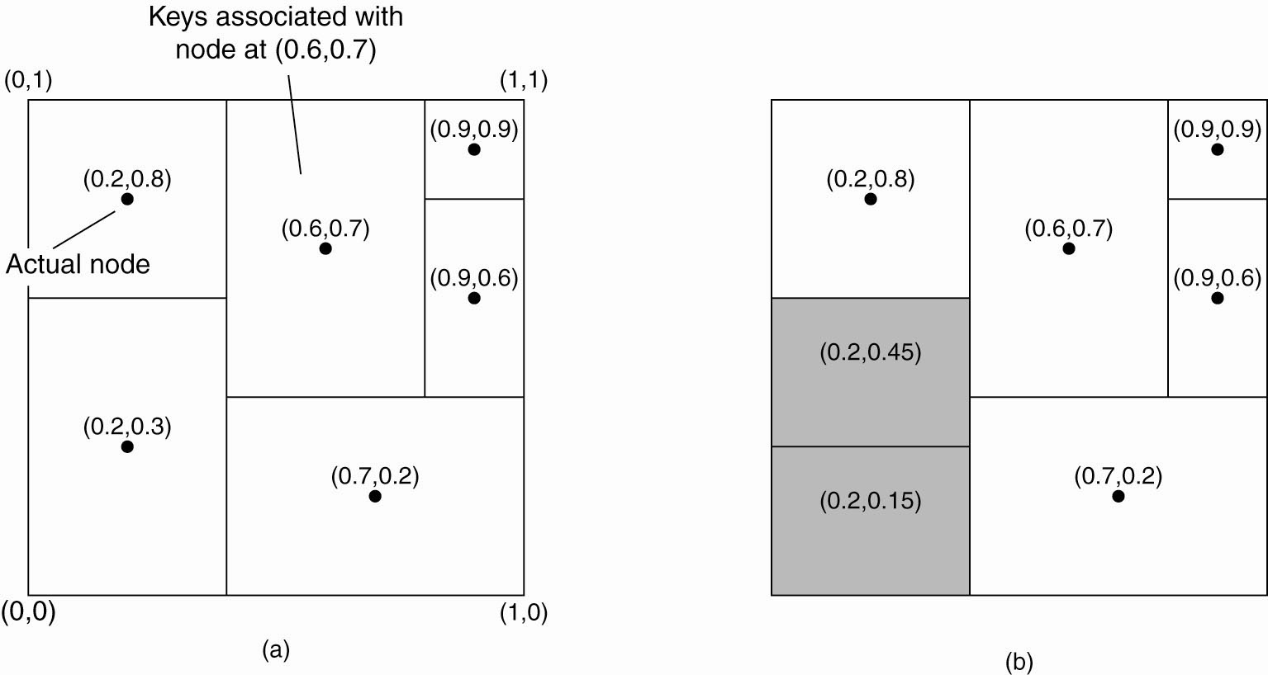
Structured Peer-to-Peer Architectures
2-dim space [0,1] x [0,1] is divided among 6 nodes
Each node has an associated region
Every data item in CAN will be assigned a unique point in space
A node is responsible for all data elements mapped to its region
Figure 2-8. (a) The mapping of data items onto nodes in CAN (Content Addressable Network).

Slide 52
Structured Peer-to-Peer Architectures
To add a new region, split the region
To remove an existing region, neighbor will take over
Figure 2-8. (b) Splitting a region when a node joins.

